Slide 1
Morphological Image Processing
邸慧军
ajon@bit.edu.cn
计算机学院
智能信息技术北京市重点实验室
图像计算与感知智能研究所

Slide 2

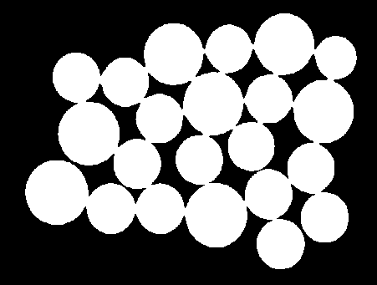

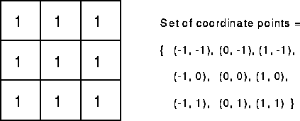
A first Example: Erosion
Applied Structuring Element:

Slide 3
Content
Preliminaries
Dilation and erosion
Opening and closing
Hit-or-miss transformation
Some basic morphological algorithm
Extensions to Gray-Scale Images

Slide 4
Preliminaries
“Morphology “ – a branch in biology that deals with the form and structure of animals and plants.
“Mathematical Morphology” – as a tool for extracting image components, that are useful in the representation and description of region shape.
The language of mathematical morphology is – Set theory.
Unified and powerful approach to numerous image processing problems.
In binary images , the set elements are members of the 2-D integer space – Z². where each element (x,y) is a coordinate of a black (or white) pixel in the image.

Slide 5
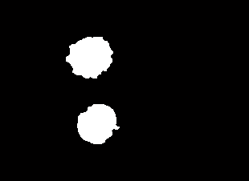
Preliminaries
Sets in mathematical morphology represent objects in an image
Example
Binary image: the elements of a set is the coordinate (x,y) of the pixels, in Z²
Gray-level image: the element of a set is the triple, (x, y, gray-value), in Z³

Slide 6
Preliminaries Basic Concepts in Set Theory
Subset
Union
Intersection
disjoint / mutually exclusive
Complement
Difference
Reflection
Translation
^

Slide 7
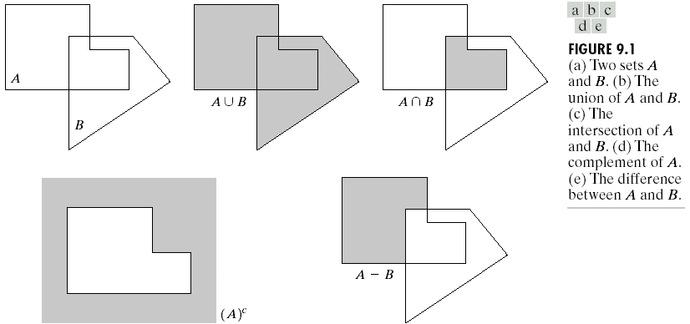
Preliminaries
Some Basic Concepts from Set Theory

Slide 8
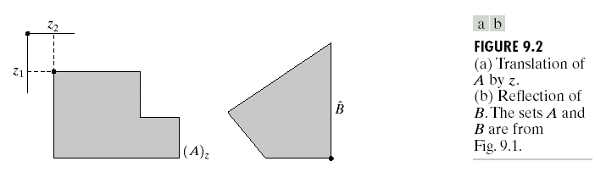
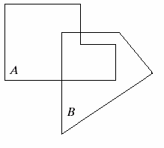
Preliminaries
Some Basic Concepts from Set Theory
Translation
Reflection

Slide 9
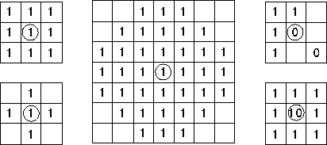
Preliminaries Structuring Element (Kernel)
Structuring Elements can have varying sizes
Usually, element values are 0,1 and none(!)
Structural Elements have an origin
For thinning, other values are possible
Empty spots in the Structuring Elements are don’t care’s!
Box
Disc
Examples of stucturing elements

Slide 10
Content
Preliminaries
Dilation and erosion
Opening and closing
Hit-or-miss transformation
Some basic morphological algorithm
Extensions to Gray-Scale Images

Slide 11
Dilation & Erosion
Basic operations
Are dual to each other:
Erosion shrinks foreground, enlarges Background
Dilation enlarges foreground, shrinks background

Slide 12
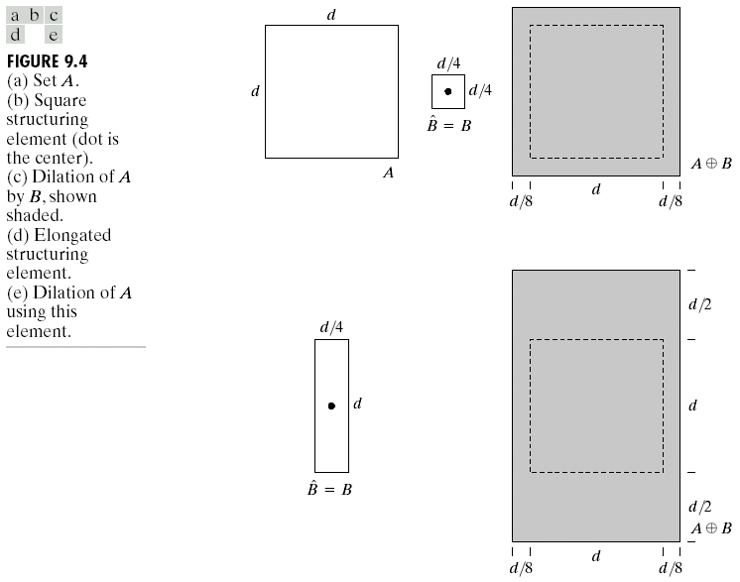
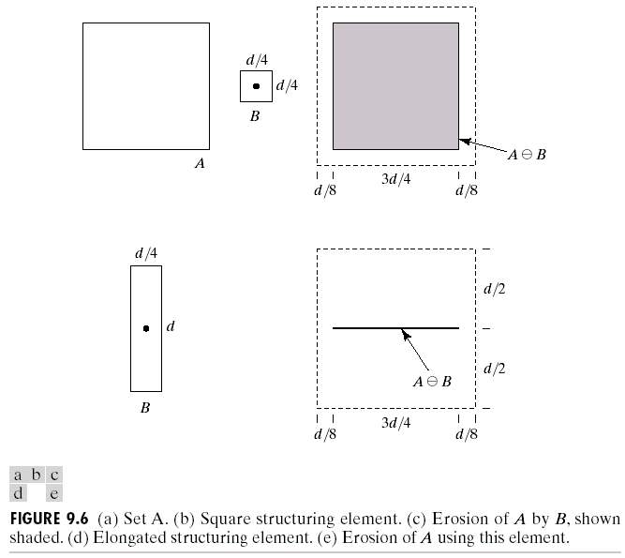
Dilation and Erosion
Dilation
B: structure element
Erosion
A  B = {z | (B)_{z} ⊆ A}
Relations
(A  B)^{c} =

Slide 13
Content
Preliminaries
Dilation and erosion
Erosion
Dilation
Opening and closing
Hit-or-miss transformation
Some basic morphological algorithm
Extensions to Gray-Scale Images

Slide 14
Erosion
Erosion is an important morphological operation
Applied Structuring Element:

Slide 15
Erosion
Erosion is the set of all points in the image, where the structuring element “fits into”.
Consider each foreground pixel in the input image
If the structuring element fits in, write a “1” at the origin of the structuring element!
Simple application of pattern matching
Input:
Binary Image (Gray value)
Structuring Element, containing only 1s!

Slide 16
Erosion

Slide 17
Example for Erosion
Input image
1 | 0 | 0 | 0 | 1 | 1 | 1 | 0 | 1 | 1
Structuring Element
1
1
1
Output Image
 | 0

Slide 18
Example for Erosion
Input image
1 | 0 | 0 | 0 | 1 | 1 | 1 | 0 | 1 | 1
Structuring Element
1
1
1
Output Image
 | 0 | 0

Slide 19
Example for Erosion
Input image
1 | 0 | 0 | 0 | 1 | 1 | 1 | 0 | 1 | 1
Structuring Element
1
1
1
Output Image
 | 0 | 0 | 0

Slide 20
Example for Erosion
Input image
1 | 0 | 0 | 0 | 1 | 1 | 1 | 0 | 1 | 1
Structuring Element
1
1
1
Output Image
 | 0 | 0 | 0 | 0

Slide 21
Example for Erosion
Input image
1 | 0 | 0 | 0 | 1 | 1 | 1 | 0 | 1 | 1
Structuring Element
1
1
1
Output Image
 | 0 | 0 | 0 | 0 | 1

Slide 22
Example for Erosion
Input image
1 | 0 | 0 | 0 | 1 | 1 | 1 | 0 | 1 | 1
Structuring Element
1
1
1
Output Image
 | 0 | 0 | 0 | 0 | 1 | 0

Slide 23
Example for Erosion
Input image
1 | 0 | 0 | 0 | 1 | 1 | 1 | 0 | 1 | 1
Structuring Element
1
1
1
Output Image
 | 0 | 0 | 0 | 0 | 1 | 0 | 0

Slide 24
Example for Erosion
Input image
1 | 0 | 0 | 0 | 1 | 1 | 1 | 0 | 1 | 1
Structuring Element
1
1
1
Output Image
 | 0 | 0 | 0 | 0 | 1 | 0 | 0 | 0

Slide 25


Another example of erosion

Slide 26
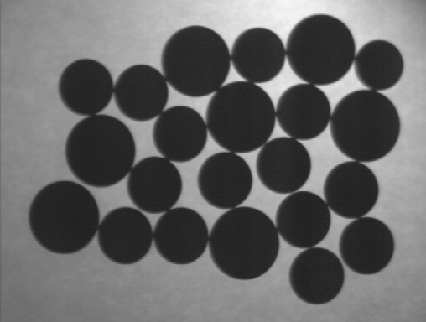


Counting Coins
Counting coins is difficult because they touch each other!
Solution: Binarization and Erosion separates them!

Slide 27
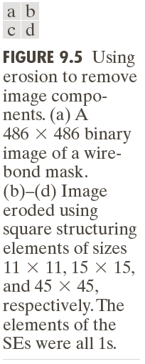
Example of Erosion (2)

Slide 28
Content
Preliminaries
Dilation and erosion
Erosion
Dilation
Opening and closing
Hit-or-miss transformation
Some basic morphological algorithm
Extensions to Gray-Scale Images

Slide 29
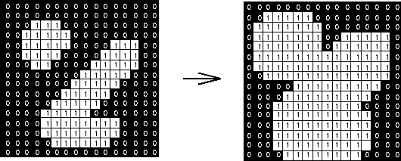
Dilation
Dilation is an important morphological operation
Applied Structuring Element:

Slide 30
Dilation
Dilation is the set of all points in the image, where the structuring element “touches” the foreground.
Consider each pixel in the input image
If the structuring element touches the foreground image, write a “1” at the origin of the structuring element!
Input:
Binary Image
Structuring Element, containing only 1s!!

Slide 31
Dilation
∅

Slide 32
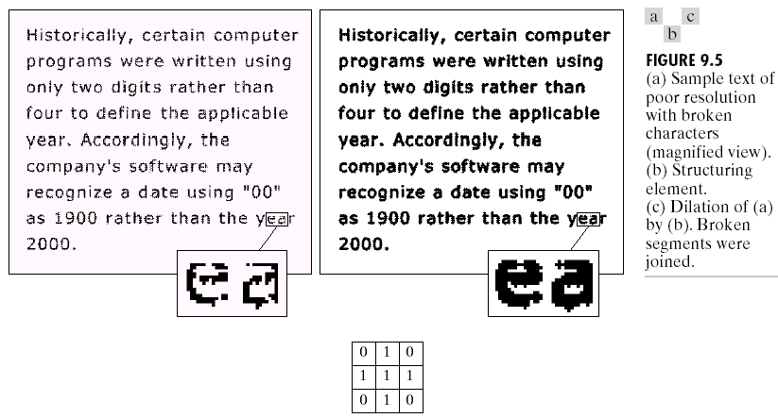
Application of dilation: bridging gaps in images
Effects: increase size, fill gap
Structuring
element
max. gap=2 pixels

Slide 33

Another Dilation Example

Slide 34
Dilation and erosion are duals
∅
∅
∅

Slide 35
Content
Preliminaries
Dilation and erosion
Opening and closing
Hit-or-miss transformation
Some basic morphological algorithm
Extensions to Gray-Scale Images

Slide 36
Combining erosion and dilation
WANTED:
remove structures / fill holes
without affecting remaining parts
SOLUTION:
combine erosion and dilation
(using same SE)

Slide 37
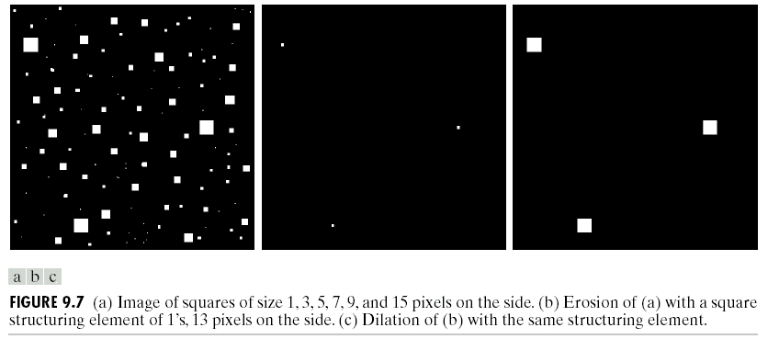
Erosion : eliminating irrelevant detail
structuring element B = 13x13 pixels of gray level 1

Slide 38
Opening & Closing
Important operations
Derived from the fundamental operations
Dilatation
Erosion
Usually applied to binary images, but gray value images are also possible
Opening and closing are dual operations

Slide 39
Content
Preliminaries
Dilation and erosion
Opening and closing
Opening
Closing
Hit-or-miss transformation
Some basic morphological algorithm
Extensions to Gray-Scale Images

Slide 40
Opening
Similar to Erosion
Spot and noise removal
Less destructive
eliminates protrusions
breaks necks
smoothes contour
Erosion next dilation
the same structuring element for both operations.
Input:
Binary Image
Structuring Element, containing only 1s!

Slide 41
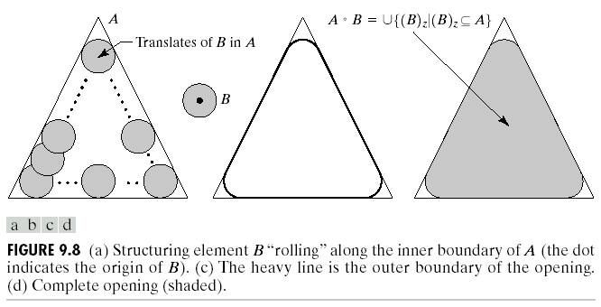
Opening

Slide 42
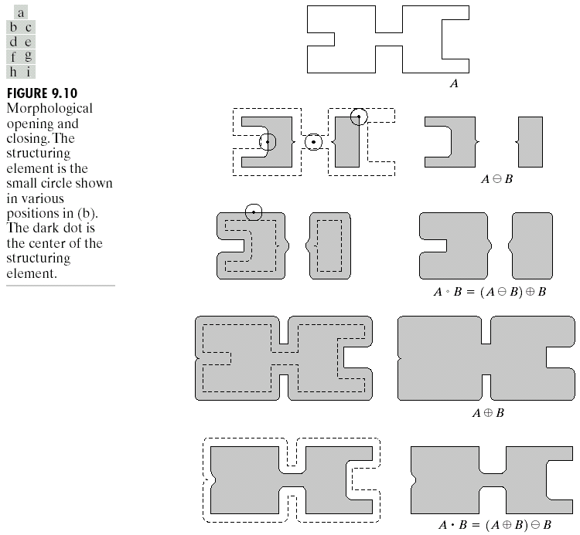
Opening (cont.)

Slide 43

Opening
Structuring element: 3x3 square

Slide 44

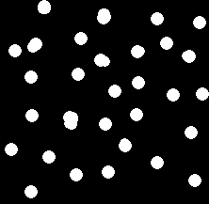
Opening Example
Opening with a 11 pixel diameter disc

Slide 45

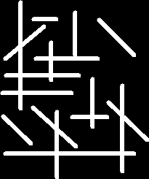

Opening Example
3x9 and 9x3 Structuring Element
3*9
9*3

Slide 46
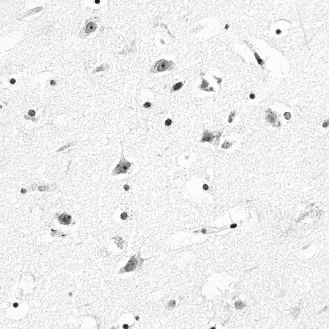
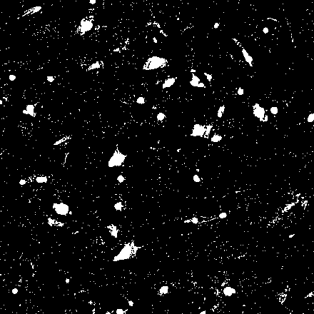
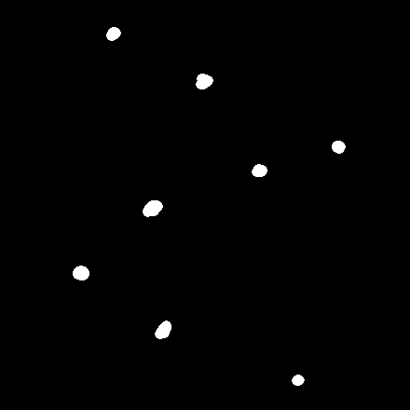
Use Opening for Separating Blobs
Use large structuring element that fits into the big blobs
Structuring Element: 11 pixel disc

Slide 47
Content
Preliminaries
Dilation and erosion
Opening and closing
Opening
Closing
Hit-or-miss transformation
Some basic morphological algorithm
Extensions to Gray-Scale Images

Slide 48
Closing
Similar to Dilation
Tends to enlarge regions, shrink background
smooth contour
fuse narrow breaks and long thin gulfs
eliminate small holes
fill gaps in the contour
Dilation next erosion!
using the same structuring element
Input:
Binary Image
Structuring Element, containing only 1s!

Slide 49
Duality
Opening and closing are dual with respect to complementation and reflection

Slide 50
Opening & Closing
Opening is the dual of closing
i.e. opening the foreground pixels with a particular structuring element
is equivalent to closing the background pixels with the same element.

Slide 51
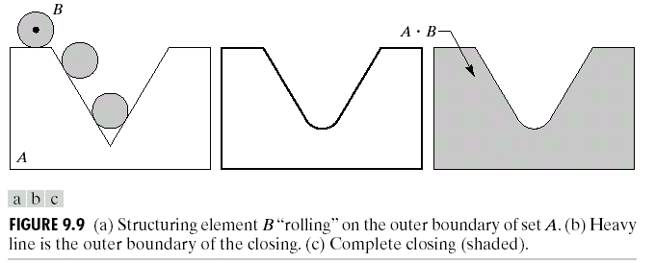
Closing
A • B = (A ⊕ B)  B

Slide 52
Closing

Slide 53

Closing
Structuring element: 3x3 square

Slide 54


Closing Example
Closing operation with a 22 pixel disc
Closes small holes in the foreground

Slide 55



Closing Example 1
Threshold
Closing with disc of size 20
Thresholded closed

Slide 56
Properties of opening and closing
Opening
Closing

Slide 57
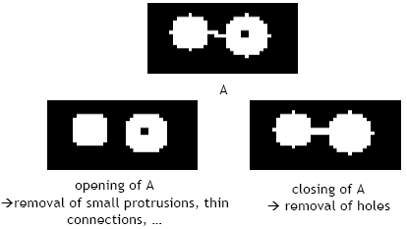
Useful: open & close

Slide 58
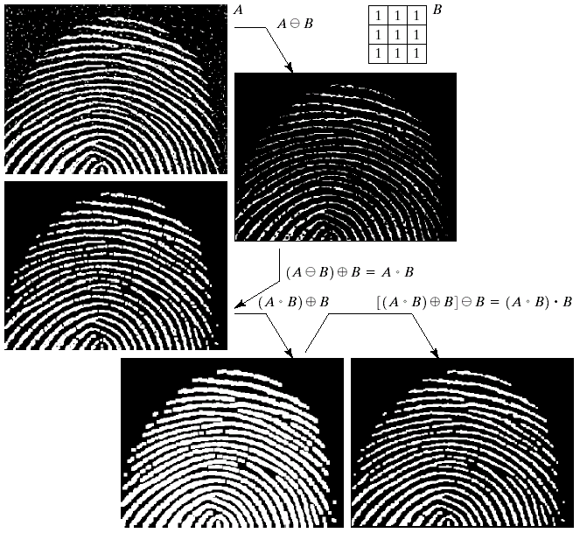
Noisy
image
Remove
outer
noise
opening
closing
Remove
inner
noise

Slide 59
Content
Preliminaries
Dilation and erosion
Opening and closing
Hit-or-miss transformation
Some basic morphological algorithm
Extensions to Gray-Scale Images

Slide 60
Hit-and-miss Transform
Used to look for particular patterns of foreground and background pixels
Very simple object recognition
All other morphological operations can be derived from it!!
Input:
Binary Image
Structuring Element, containing 0s and 1s!!

Slide 61
Hit-and-miss Transform
Similar to Pattern Matching:
If foreground and background pixels in the structuring element exactly match foreground and background pixels in the image, then the pixel underneath the origin of the structuring element is set to the foreground color.

Slide 62
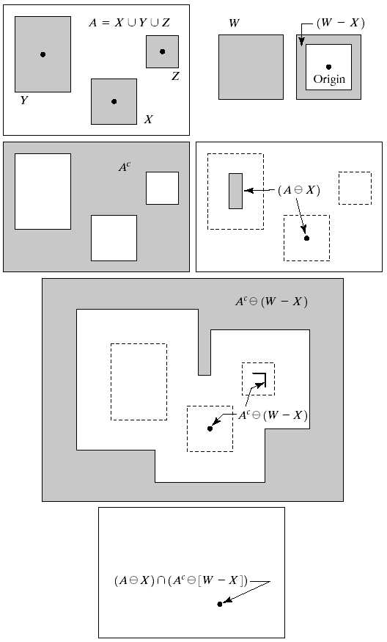
Hit-or-miss transformation
Find the location of certain shape
X
erosion
Find the set of pixels that
contain shape X

Slide 63
Hit-or-miss transformation
Detect object via
background
Erosion
with (W-X)

Slide 64
Hit-or-miss transformation
Eliminate un-necessary parts
AND

Slide 65
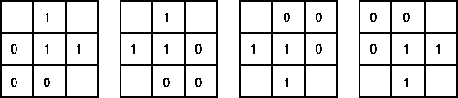
Corner Detection with Hit-and-miss Transform
Structuring Elements representing four corners

Slide 66

Corner Detection with Hit-and-miss Transform
Apply each Structuring Element
Use OR operation to combine the four results

Slide 67
Content
Preliminaries
Dilation and erosion
Opening and closing
Hit-or-miss transformation
Some basic morphological algorithm
Boundary extraction
Region Filling
Extraction of connected components
Convex hull
Thinning
Thickening
Skeleton
Extensions to Gray-Scale Images

Slide 68
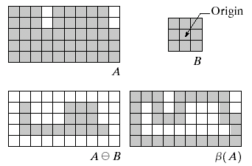
Boundary extraction
Extract boundary of a set A:
First erode A (make A smaller)
A – erode(A)
=

Slide 69

Boundary extraction

Slide 70
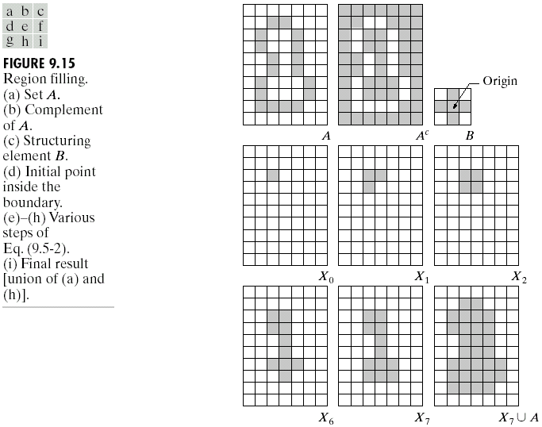
Region Filling

Slide 71
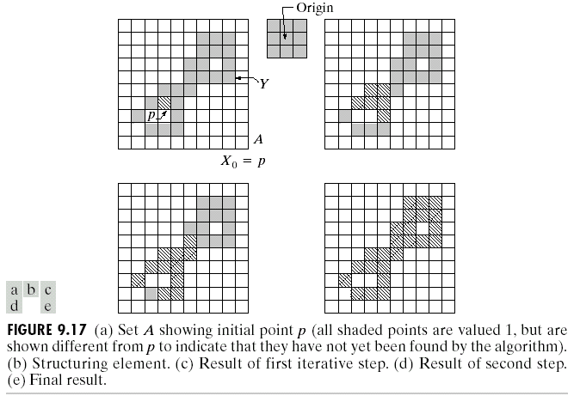
Extraction of connected components

Slide 72
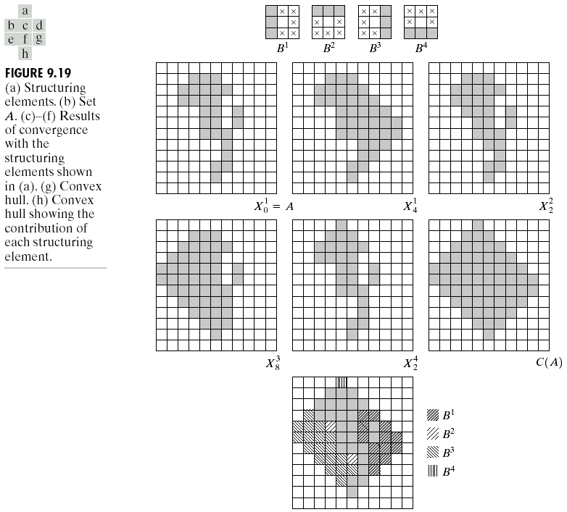
Convex hull
A set A is is said to be convex if the straight line segment joining any two points in A lies entirely within A.

Slide 73
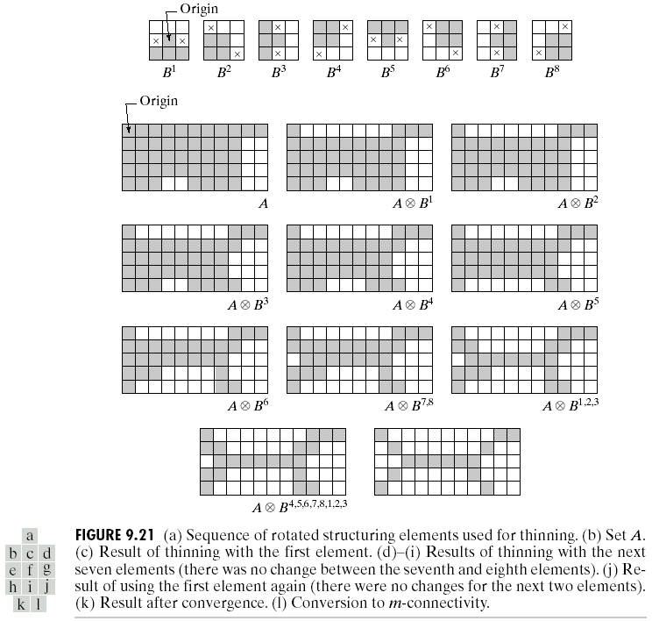
Thinning

Slide 74
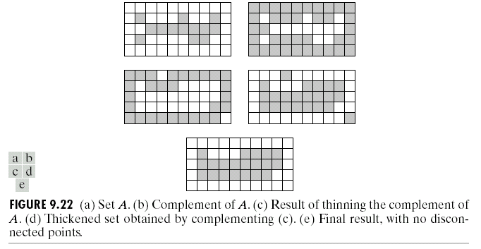
Thickening
A{B} =((…(AB¹) B²) … B^{n})
Thickening is the dual of thinning
operation. Usually, thickening a set A is accomplished by thinning A^{c}, and then complement the result. Then a post-processing prunning process is applied to remove disconnected points as shown to the left.

Slide 75
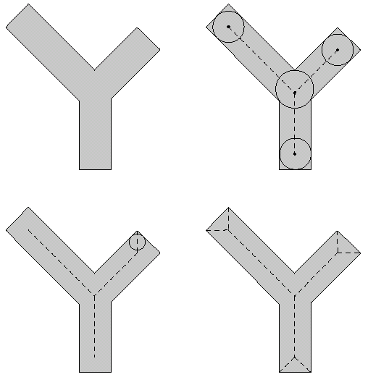
Skeleton
A skeleton of a set A consists of points z that is the center of a maximum disk
A maximum disk is a circle in A that can not be enclosed by another circle that is also in A.
Figure 9.23. (a) set A, (b), (c) sets of possible maximum disks. (d) dotted line is the skeleton.

Slide 76
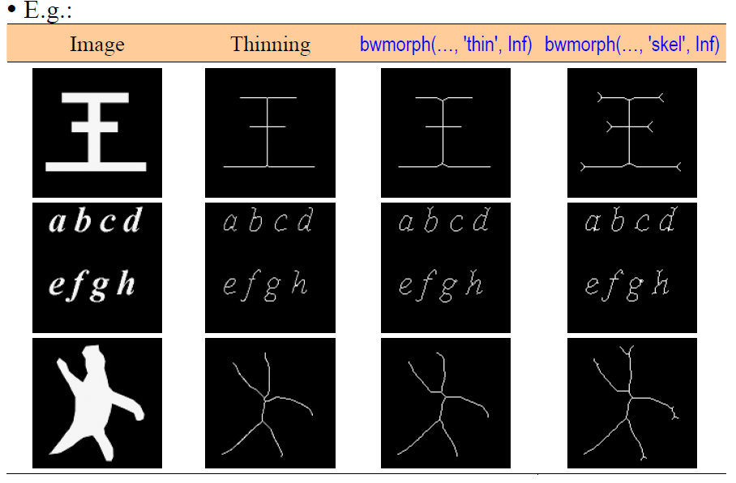

Slide 77
Content
Preliminaries
Dilation and erosion
Opening and closing
Hit-or-miss transformation
Some basic morphological algorithm
Extensions to Gray-Scale Images

Slide 78
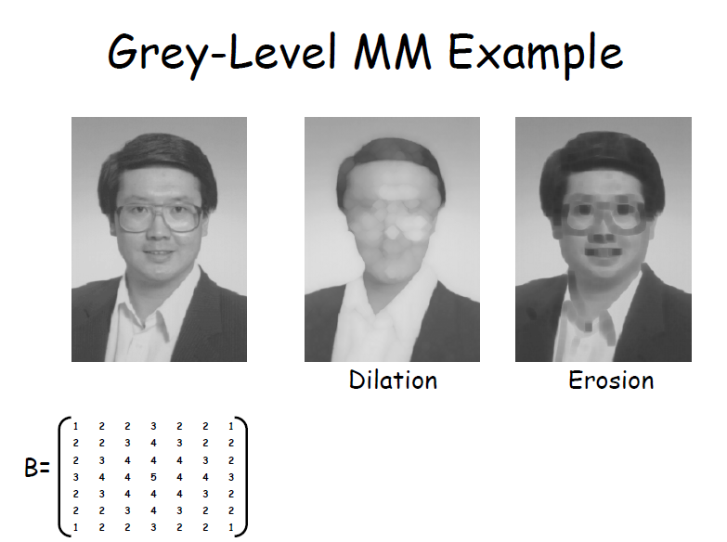
Extensions to Gray-Scale Images

Slide 79
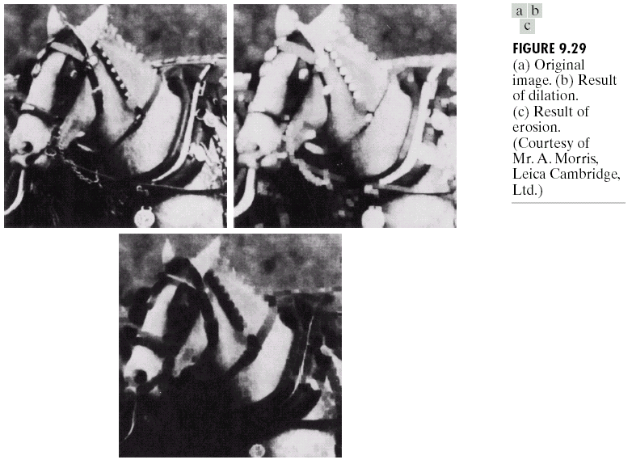
Extensions to Gray-Scale Images

Slide 80
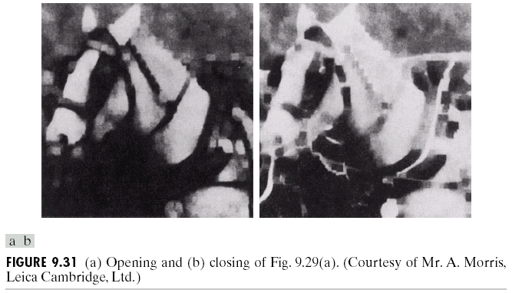
Extensions to Gray-Scale Images

Slide 81
Extensions to Gray-Scale Images
Morphological smoothing
Perform opening followed by a closing
The net result of these two operations is to remove or attenuate both bright and dark artifacts or noise.
Morphological gradient
Dilation and erosion are use to compute the morphological gradient of an image, denoted g:
It uses to highlights sharp gray-level transitions in the input image.
Obtained using symmetrical structuring elements tend to depend less on edge directionality.

Slide 82
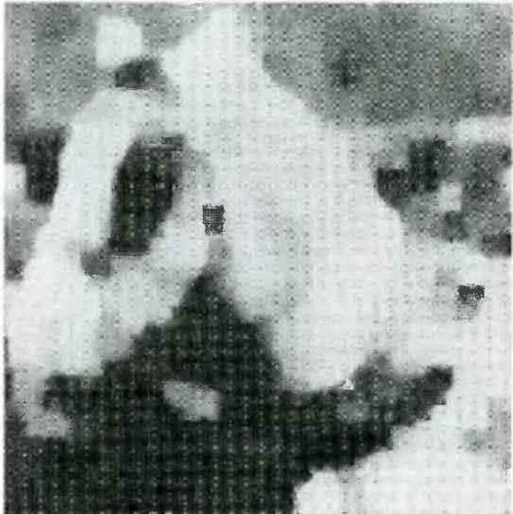
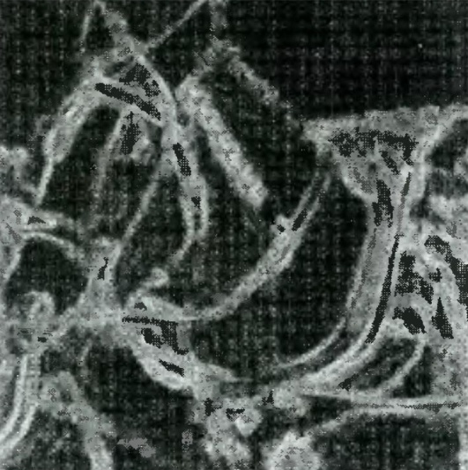
Extensions to Gray-Scale Images
Morphological smoothing
Morphological gradient

Slide 83
Textual Segmentation

Slide 84
End

